Slide 1

Technical Review Of Revenue Model
Aaren Stubberfield

Slide 2
Agenda:
Problem Statement
Data Exploration – Important Relationships
Data Preparation – Filtering
Final Model Detailed
Next Steps
Additional Insight
Appendix

Slide 3
Problem Statement
Develop a predictive model of the revenue earned for a truck shipment.

Slide 4

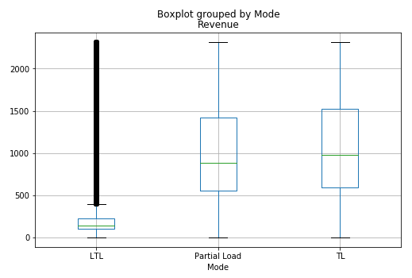
Data Exploration – Important Relationships
Four key relationships identified
Mode Type impacted Revenue (LTL earned Less Revenue)

Slide 5
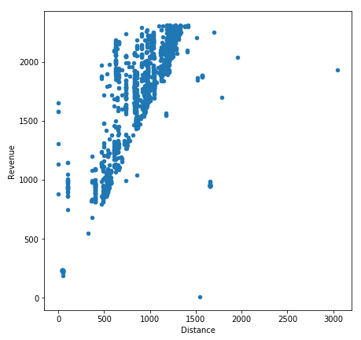
Data Exploration – Important Relationships
Four key relationships identified
Mode Type impacted Revenue (LTL earned Less Revenue)
Distance impacted Revenue (Revenue Showed a Strong Positive Correlation with Distance)

Slide 6
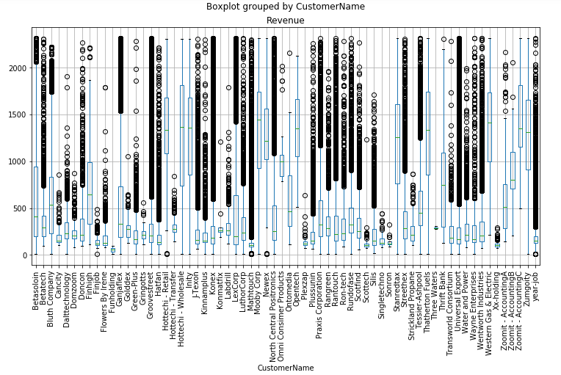
Data Exploration – Important Relationships
Four key relationships identified
Mode Type impacted Revenue (LTL earned Less Revenue)
Distance impacted Revenue (Revenue Showed a Strong Positive Correlation with Distance)
Customer impacted Revenue WITH some paying more

Slide 7
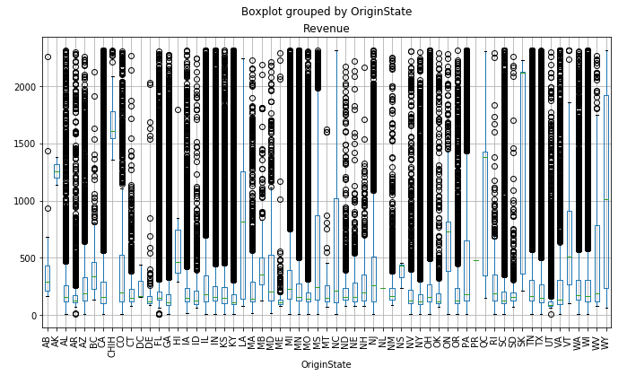
Data Exploration – Important Relationships
Four key relationships identified
Mode Type impacted Revenue (LTL earned Less Revenue)
Distance impacted Revenue (Revenue Showed a Strong Positive Correlation with Distance)
Customer impacted Revenue WITH some paying more
Origin / Destination impacted Revenue

Slide 8
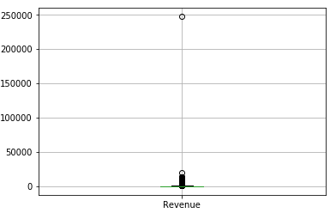
Data Preparation – Filtering
The Revenue feature contained some extreme values
Used z-scoring to remove outliers
Created Date Feature contained a number of future dates (i.e. 2020).
Data was filtered to 8/2016 to 8/2019
Boxplot of Revenue

Slide 9
Final Model
Most Important Feature
Feature | Feature Description
Mode_TL | Indicator of “Full Truck Load” Shipping Mode
CustMedianRev | Historical Median Revenue based On Customer from training dataset only
Mode_Partial Load | Indicator of “Partial Truck Load” Shipping Mode
Dist*CustMedianRev | Distance feature multiplied by CustMedianRev feature
Distance | Miles from Pickup to Destination
OSMedianRev | Historical Median Revenue based Origin State from training dataset only
Dist-OSMedianRev | Distance feature subtracted by OSMedianRev feature
Dist-CustMedianRev | Distance feature subtracted by CustMedianRev
DSMedianRev | Historical Median Revenue based Destination State from training dataset only
Least Important Feature
The Permutation method was used to determine Feature Importance

Slide 10
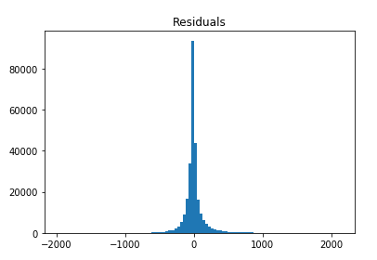
Final Model
Model Type – Random Forest (20 Trees)
Test set Performance
The R2: 80.6%, MSE: 24226.15
Statistics Of Residuals:
Mean: -0.81
STDEV: 155.64
Overall: The model is able to explain about 81% of the variation in revenue. However, it does have a large standard deviation due to some large residuals.

Slide 11
Next Steps
Look to improve the model by
Exploring different variable interactions
Exploring different machine learning models and scaling methods
Communicate to Business About Data cleaning
Noticed delivery dates in the future (i.e. 2020)

Slide 12
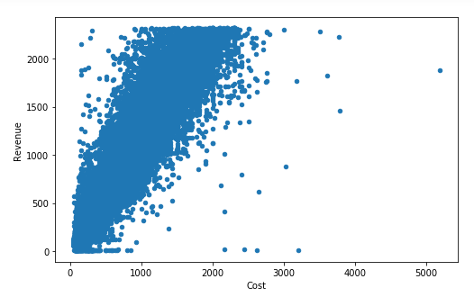
Additional insight
Revenue predictions could be used to estimate cost.
I assumed that the cost feature would not be available when making predictions. Therefore, it was not used in the models.
However, There is a strong relationship between revenue and cost.

Slide 13
APPENDIX

Slide 14
Model Code
My code can be found at https://github.com/stubberf/TruckCaseStudy

